Slide 1
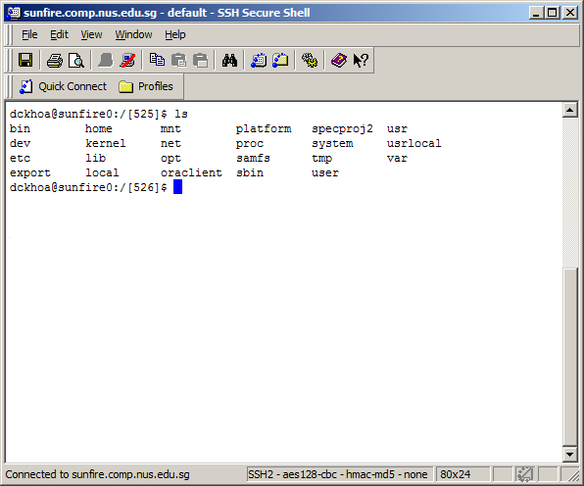
Command line interface
Launching program by typing name follow by parameters
Notes:
The shell is based on a command line interface (CLI), this is in contrast to the more commonly seen graphical user interface (GUI) which you are familiar with.
In CLI, programs are launched by typing their name, instead of clicking on their icons as in graphic user interface (GUI). Arguments can be sent to a program put them after programs’ names.
For examples:
ls /dev/ttyUSB*
aptitude install mysql-server mysql-client
sudo /etc/init.d/httpd restart

Slide 2
Command line interface
Golden rule of UNIX : Usually there is no output when the program runs successfully.
Easy to automate repetitive tasks.
Default interface when accessing remote servers.
Notes:
Silence is the golden rule of UNIX. No output means everything worked correctly.
Command line interface (CLI):
Suited to performing ad hoc operations by combining a few commands.
Easy to automate repetitive tasks.
Default interface when accessing remote servers.

